Slide 1
Invasive Species

Slide 2
By the end of the lesson, you should be able to:
1. | Explain what an invasive species is.
2. | Describe the impacts that invasive species have on ecosystems and the economy.

Slide 3
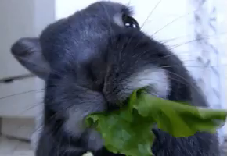
An introduced species is a species which has been released into an ecosystem where it does not occur naturally.
This can be deliberate or accidental.
When an introduced species starts to cause damage within its new ecosystem, it is considered an invasive species.

Slide 4
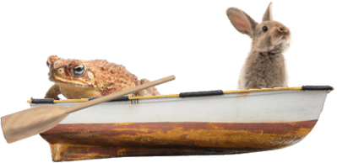
When an introduced species has few or no predators, it will breed rapidly, and increase its population size.
This can be a problem as they can take up space in an ecosystem that would usually belong to a native animal, potentially endangering native species.

Slide 5
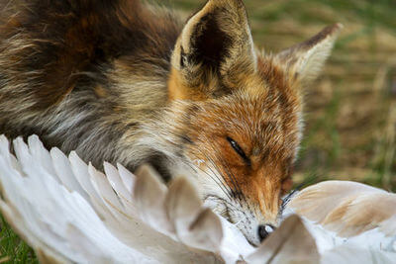
Introduced species create major disruptions within ecosystems.
This is because they can outcompete native animals for food and shelter, provide consumers with a new food source, or act as predators to a native animal.

Slide 6
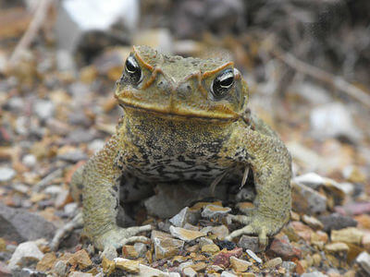
Invasive species are introduced species that cause significant damage to the native ecosystem.
They do this by outcompeting native species or disturbing the food chain.
For example, when cane toads (Rhinella marina) were introduced into Australia in 1935, they began to multiply and spread across the northeast of the country. These toads produce a toxin that kills many native predators, such as snakes and monitor lizards. They are harmful to the ecosystems that are occupied by these predators.

Slide 7
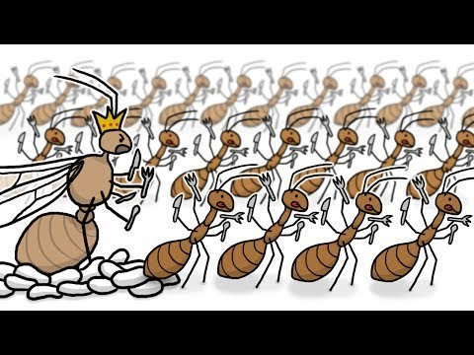

Slide 8
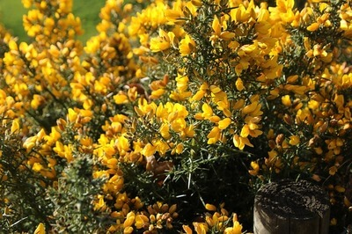
Certain characteristics can give invasive species an ecological advantage over the native species they compete with.
Some invasive species are able to grow and reproduce more quickly than native species, so their populations grow faster.
Others have the ability to reproduce sexually and asexually. In other words, they have two methods of reproduction. This characteristic is more common in flowering plants, which quickly grow and smother areas of native bush.

Slide 9
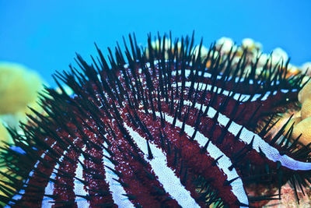
Many invasive species are so successful in their new environment because they are generalists.
This means that they can survive in many different environments. Generalists can access a wider range of resources to help them outcompete native species.
A specialist species relies on a very specific set of conditions to survive. If an invasive species outcompetes the food source of a specialist, then the specialist species will die out!

Slide 10
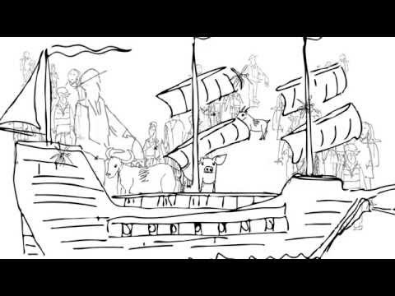

Slide 11
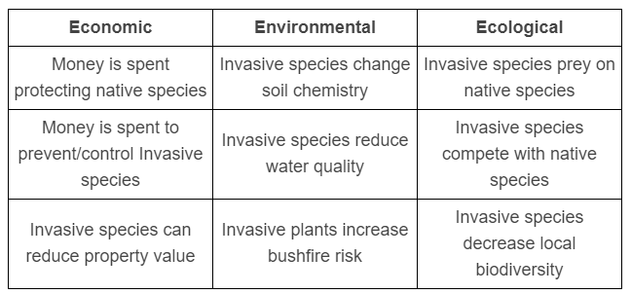
Invasive species are introduced species that cause significant damage to the native ecosystem.
They are responsible for economic, environmental and ecological damage. These effects are summarised in the table below:

Slide 12


